Slide 1
Unit Testing with JUnit
Prof. Dr. Dirk Riehle
Friedrich-Alexander University Erlangen-Nürnberg
ADAP Y02
Licensed under CC BY 4.0 International
Notes:
It is Friedrich-Alexander University Erlangen-Nürnberg – FAU, in short.
Corporate identity wants us to say “Friedrich-Alexander University”.

Slide 2
Definition Unit Testing
Recap
Unit = Component (in our context)
Often classes are seen as units
Requirement
Specification
Acceptance
Testing
Functional
Specification
System
Testing
Technical
Specification
Integration
Testing
Program
Specification
Component
Testing
Coding

Slide 3
Example of Test Harness
JUnit (Java Unit Testing Framework)
  A test harness implemented as an object-oriented testing framework
  Supports tests and test suites, set-ups, tear-downs, etc.
  Small and simple, easy to learn
  Well-supported by tools / integrated into IDEs like Eclipse
JUnit popularized unit testing: “Never in the field of software development have so many owed so much to so few lines of code.” [M07]

Slide 4
JUnit Information
Available from http://junit.org
  Comes as pre-installed plug-in with Eclipse and most other IDEs
  See course literature for an introduction to JUnit
Version history of JUnit
  Prior to JUnit 4 conventions rather than annotations
  Wahlzeit uses JUnit 4
JUnit 5
  Is the new major version of the testing framework
  Is a complete rewrite of JUnit 4
  Provides new foundation for developer-side testing on the JVM
  Uses Java 8 features, for example, lambdas
  Has a modular concept, imports only what is needed

Slide 5
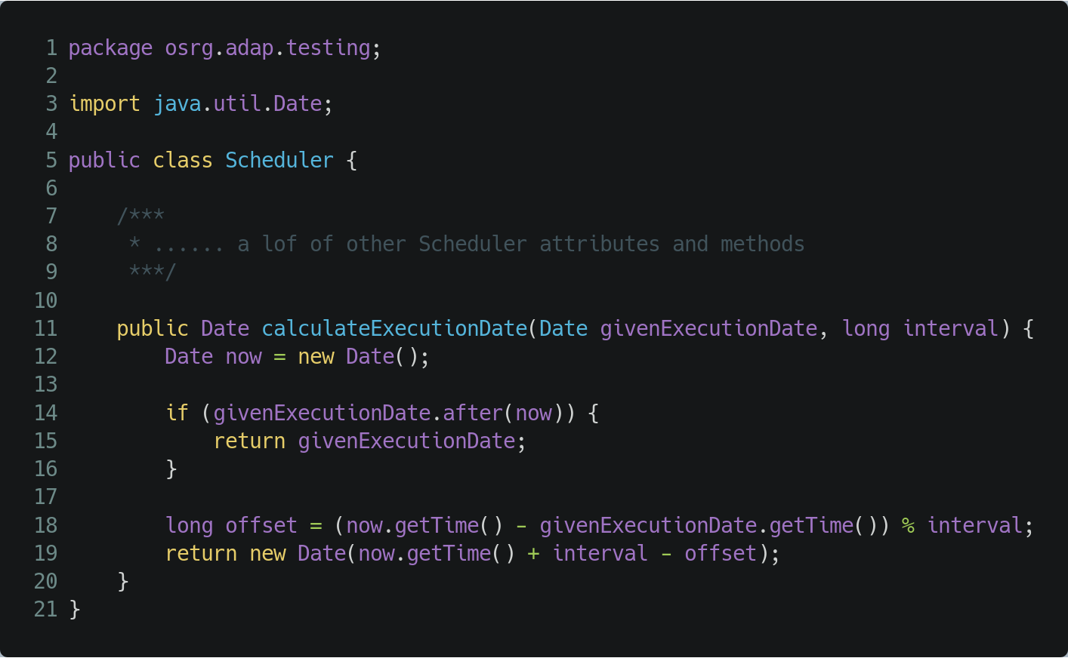
JUnit Example: Component Under Test
Scheduler for tasks that are triggered the first time on a certain point in time and then in a defined fix interval

Slide 6
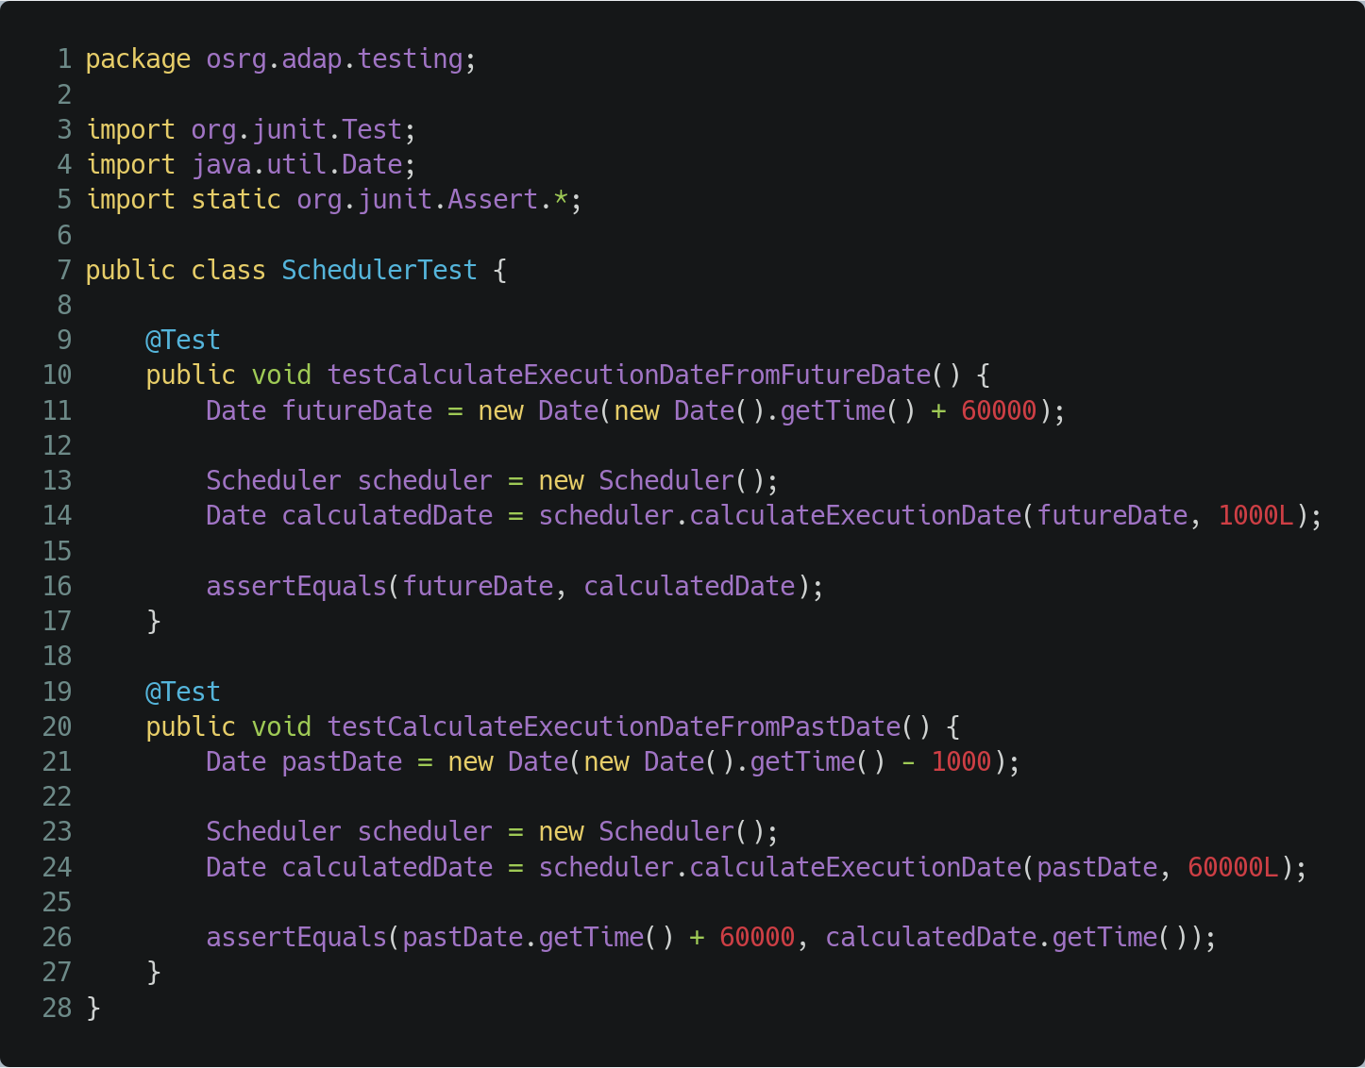
JUnit Example: Simple Unit Tests (1/2)
Annotate test method with @Test
Conventions:
  Containing class name ends with ‘Test’
  Test methods start with ‘test’
  File locations depend on build tool, e.g. Gradle
    Sources: $project/src/main/java
    Tests: $project/src/test/java
  Test package hierarchy should mirror the main hierarchy

Slide 7
JUnit Example: Simple Unit Tests (2/2)
Assertions for checking the results
Explicit assertions / failures in code
  assert(...)
  fail(...)
Annotations with expected results
  @Test(expected = SomeException.class)
  @Test(timeout = 500)

Slide 8
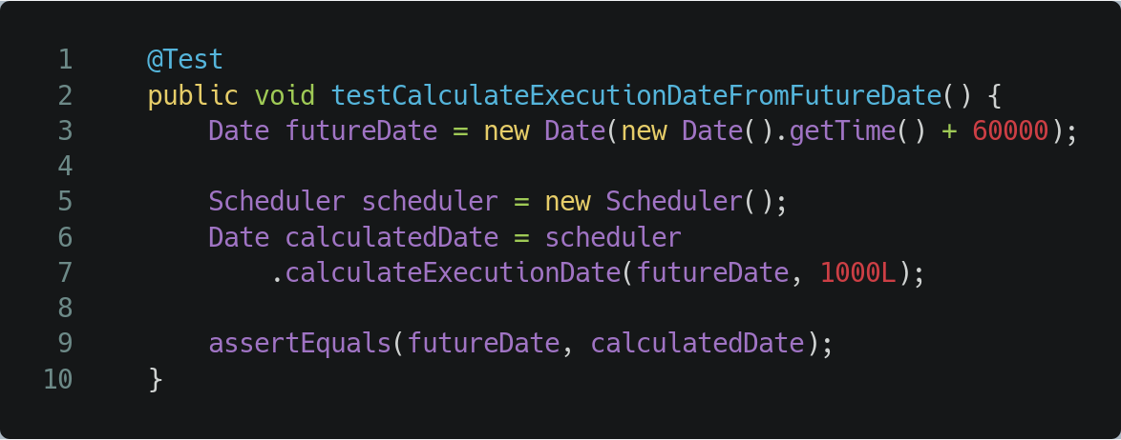
3A Pattern
Arrange
Act (execute)
Assert (check)

Slide 9
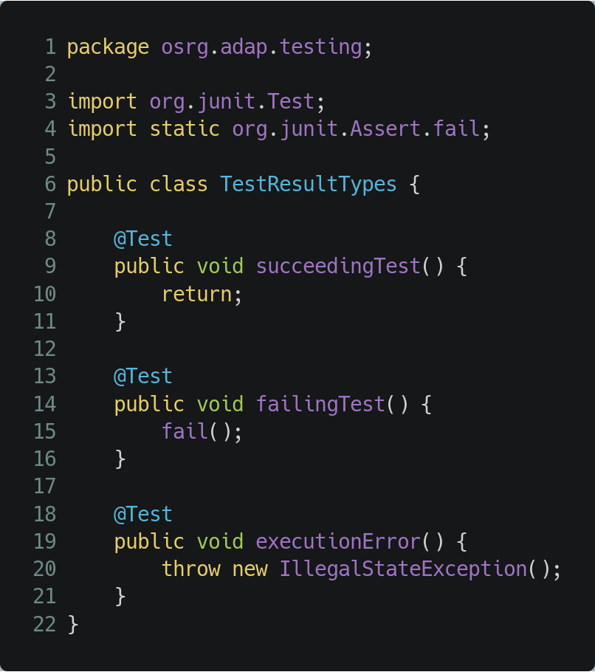
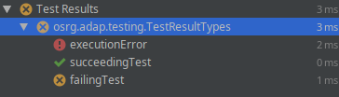
Test Results
Pass
Fail
Test execution error
a) Program is defect
b) Test is defect

Slide 10
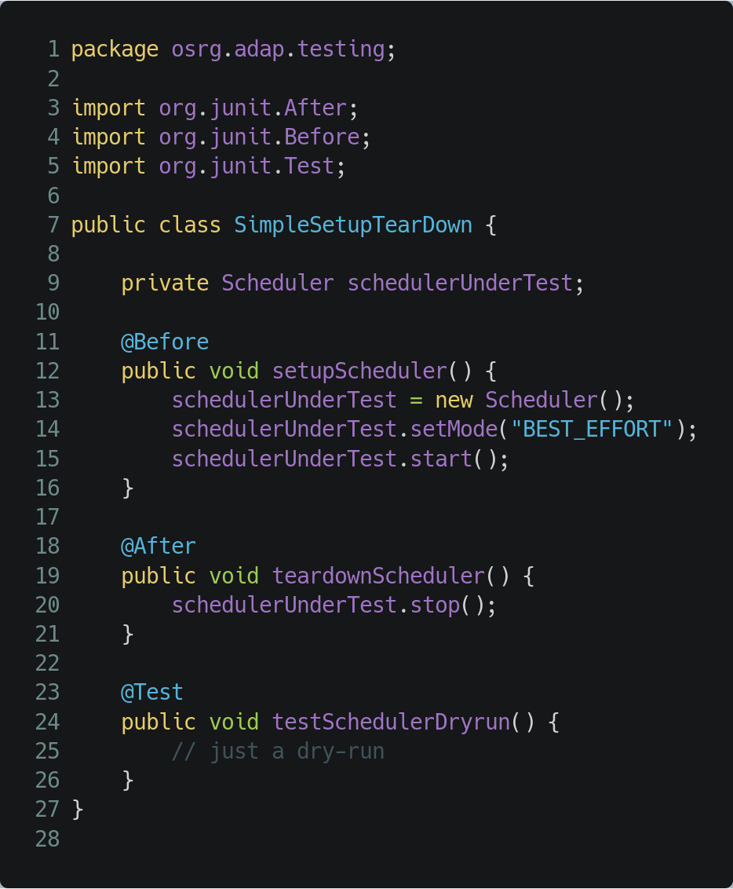
JUnit Static Test Setup & Teardown
Setting up / tearing down test environment
for every test in a class
  @Before
  @After
Setting up / tearing down test environment
once for all tests in a class
  @BeforeClass
  @AfterClass

Slide 11
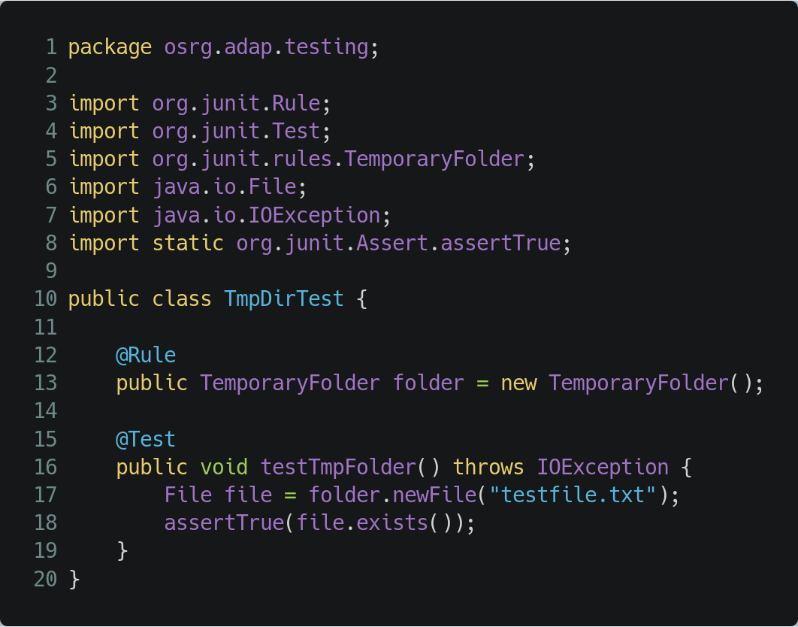
JUnit Dynamic Test Setup & Teardown
Reusable Setup and Teardown
TestRule
  e.g. TmpDir Rule
    Temporary directory that is cleared after each test case
  Rule chain supports composition of test rules
    Rule chain lines up test rules in sequence
    Fluid programming style chains methods
  Use @Rule and @ClassRule analogous to @Before and @BeforeClass
ExternalResource
  More complex set-ups to be run once or only a few times
  Applies, for example, to heavyweight database set-up

Slide 12
Changes in JUnit Versions
Tests are implemented in test classes
  JUnit 3.8 or before
    Start test method name with “test”
    End test class name with “Test”
  JUnit 4
    Annotate test method with @Test
    Annotate set-up methods with @Before and @BeforeClass
    Annotate tear-down methods with @After and @AfterClass
    End class name with Test (optional)
  JUnit 5
    Annotate test method with @Test
    Annotate set-up methods with @BeforeEach and @BeforeAll
    Annotate tear-down methods with @AfterEach and @AfterAll
    End class name with Test (optional)

Slide 13
Test Drivers and Test Doubles
Components are part of a dependency graph
We need to isolate components in order to test them as a single unit
Using components as inspiration for test drivers (calling the component under test)
Used components need to be replaced by test doubles
Component
Component
under Test
Component
Component

Slide 14
Isolating Units with Test Doubles
Test Doubles
  Object or component that we install in place of the real component for a test
Dummy Object
  Placeholder object that is passed to the SUT as an argument (or an attribute of an argument) but is never actually used
Test Stub
  Replaces component that SUT depends on, configure indirect inputs to the SUT
Mock Object
  Test Stub + ability to verify inputs of the SUT by behaviour expectation
Test Spy
  Test Stub + ability to verify inputs of the SUT by recording calls to the spy that can be verified
Fake Object
  Replaces component with an alternative implementation of the same functionality
xUnit Test Patterns: Refactoring Test Code by Gerard Meszaros,
Published by Addison-Wesley Professional, 2007

Slide 15
Mockito
Available from https://site.mockito.org/
Serves a variety of testing double functionality
  Stubbing
  Mocking
  Spying
  Etc.
Easy syntax to create test doubles
Easy syntax to verify test double behaviour
Interacts very well with JUnit

Slide 16
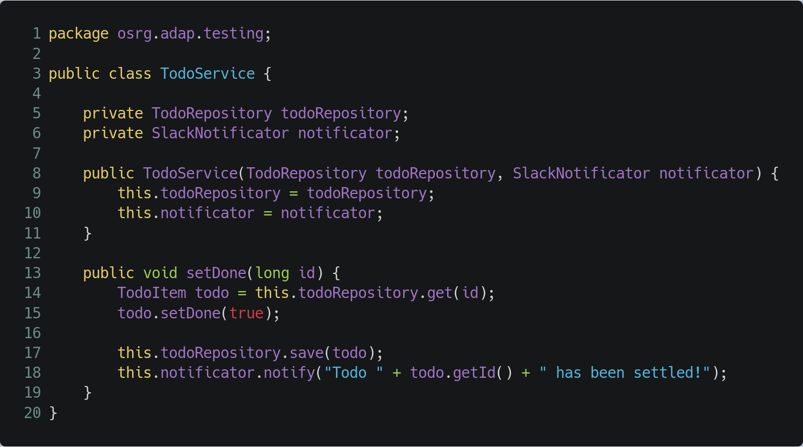
Mockito Example: Component under Test
Inversion of Control

Slide 17
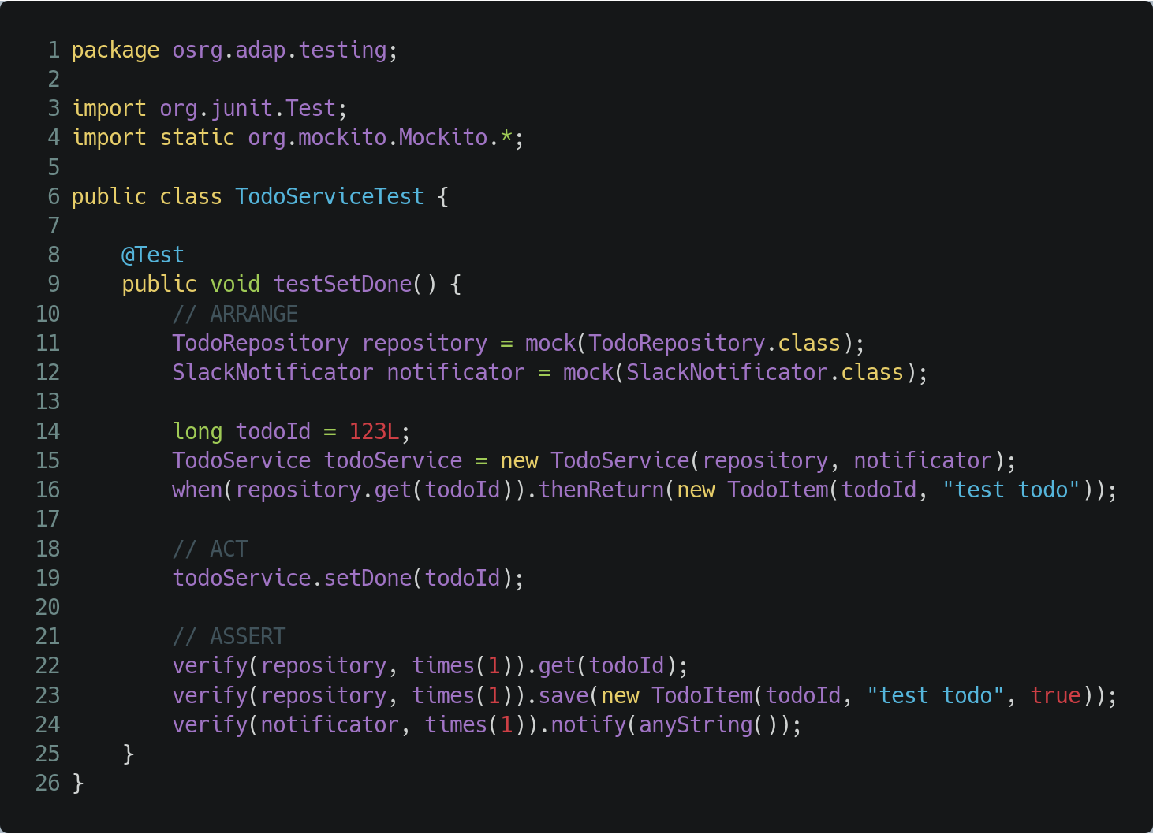
Mockito Example
Mock creation with static mock method or with @Mock annotation
Behaviour specification with static when method
Behaviour verification with static verify method
Inversion of Control

Slide 18
Thank you! Questions?
dirk.riehle@fau.de – http://osr.cs.fau.de
dirk@riehle.org – http://dirkriehle.com – @dirkriehle
DR

Slide 19
Credits and License
Original version
  © 2020 Friedrich-Alexander University Erlangen-Nürnberg and Dirk Riehle, all rights reserved
Contributions
  Georg Schwarz (2019)

